Slide 1
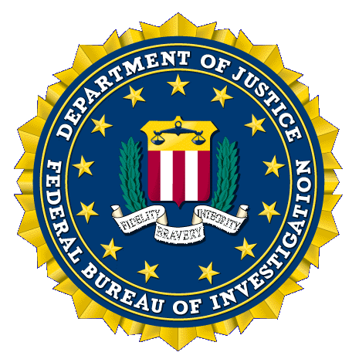
“When bad men combine, the good must associate; else they will fall, one by one, an unpitied sacrifice in a contemptible struggle.”
-Edmund Burke- 1770 Irish statesman and philosopher
Unclassified
1
Notes:
1
Provide overview of investigative background and educational experience.

Slide 2
This year, in both content and organization, this statement illustrates how quickly and radically the world—and our threat environment—are changing. This environment is demanding reevaluations of the way we do business, expanding our analytic envelope, and altering the vocabulary of intelligence.
Threats are more diverse, interconnected, and viral than at any time in history. Attacks, which might involve cyber and financial weapons, can be deniable and unattributable. Destruction can be invisible, latent, and progressive. We now monitor shifts in human geography, climate, disease, and competition for natural resources because they fuel tensions and conflicts. Local events that might seem irrelevant are more likely to affect US national security in accelerated time frames.
In this threat environment, the importance and urgency of intelligence integration cannot be overstated. Our progress cannot stop. The Intelligence Community must continue to promote collaboration among experts in every field, from the political and social sciences to natural sciences, medicine, military issues, and space. Collectors and analysts need vision across disciplines to understand how and why developments—and both state and unaffiliated actors—can spark sudden
changes with international implications.
The Intelligence Community is committed every day to providing the nuanced, multidisciplinary intelligence that policymakers, diplomats, warfighters, and international and domestic law enforcement need to protect American lives and America’s interests anywhere in the world.

