Slide 1
How Danny Taught Me About Leverage
Jim Mitchell (aka Danny’s Manager)

Slide 2
The Scenario
I had heard about Danny for years as a wild and crazy guy
2001: I finally met him at Sun
He was a researcher in Sun Labs
I was then VP of Sun Labs
We were both pilots (although I am the sane one)
2002: Danny talked me into having Sun apply for DARPA HPCS contract (something about optics & computers)
2003: I stepped aside from running labs to become PI of DARPA HPCS program at Sun

Slide 3
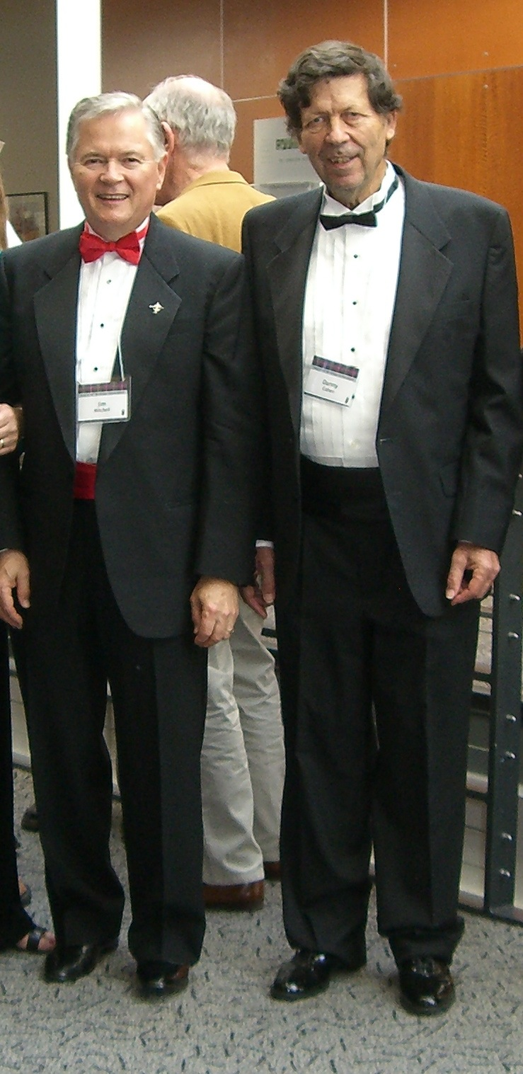
2008 I talked Danny into coming to a Computer History Museum event that required a tuxedo

Slide 4
The Plot Continues
2008: Danny says computers need to use optics for interconnects
Sun awarded DARPA contract for UNIC program in silicon photonics
Danny talks me into managing the program
I am still doing this as well as microelectronics packaging and chip interconnects
This is mostly Danny’s doing

Slide 5
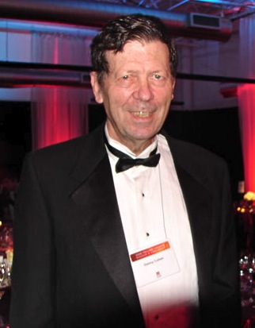
2010 Jim talks Danny into a tuxedo for the second time at another Computer History Museum event

Slide 6
The Lesson of Leverage
Danny talked me into spending 12 years pursuing interconnects and optics
I talked Danny into a tuxedo two evenings that included free food and entertainment
Who is better at leveraging others?
The question of nature versus nurture

